Slide 1
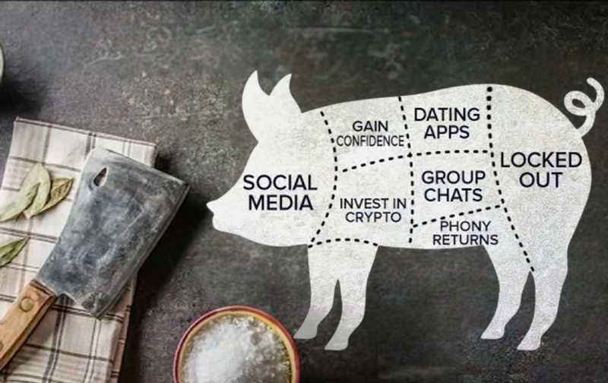
Pig Butchering in Texas Isn’t (or Ain’t) Always BBQ
Panel:
- Hon. Michael J. Truncale District Judge, EDTX
Moderator:
Thad Heartfield
The Heartfield Law Firm
- Marshal J. Hoda The Hoda Law Firm, PLLC

Slide 2
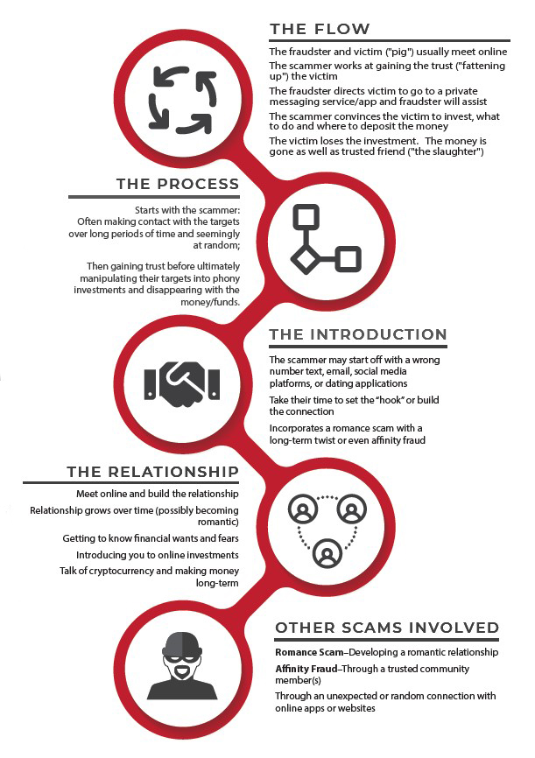
What are pig-butchering scams?
Hybrid romance/investment fraud scheme originating from SE Asia
Usually involves cryptocurrency and a fake investment app or website
Name refers to “fattening up” of a pig before slaughter

Slide 3
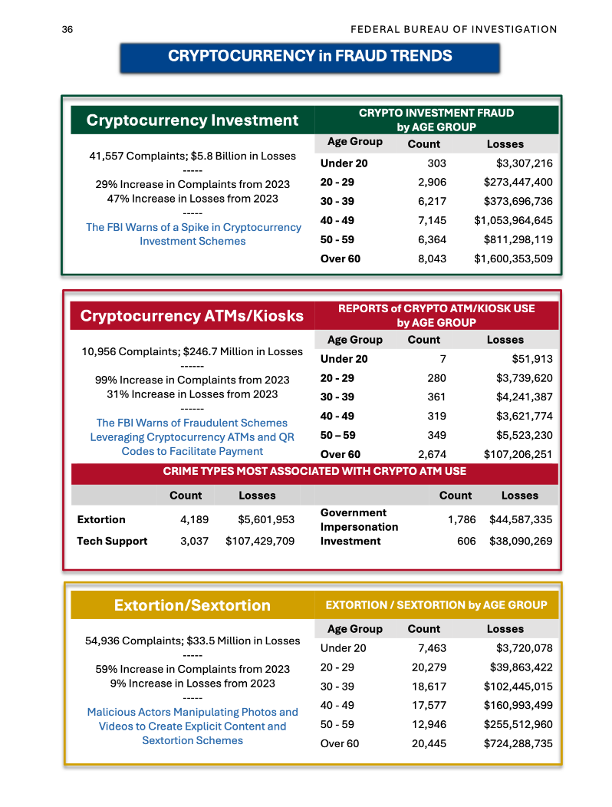
Scope of the “Scamdemic”
41,557 complaints in 2024 – 29% YOY increase
$5.8 billion in losses – 47% YOY increase
Losses distributed across age groups

Slide 4

Recovery Methods
Filing a civil lawsuit
Coordinating with local or federal law enforcement
Tracing stolen assets to already-frozen crypto addresses

Slide 5
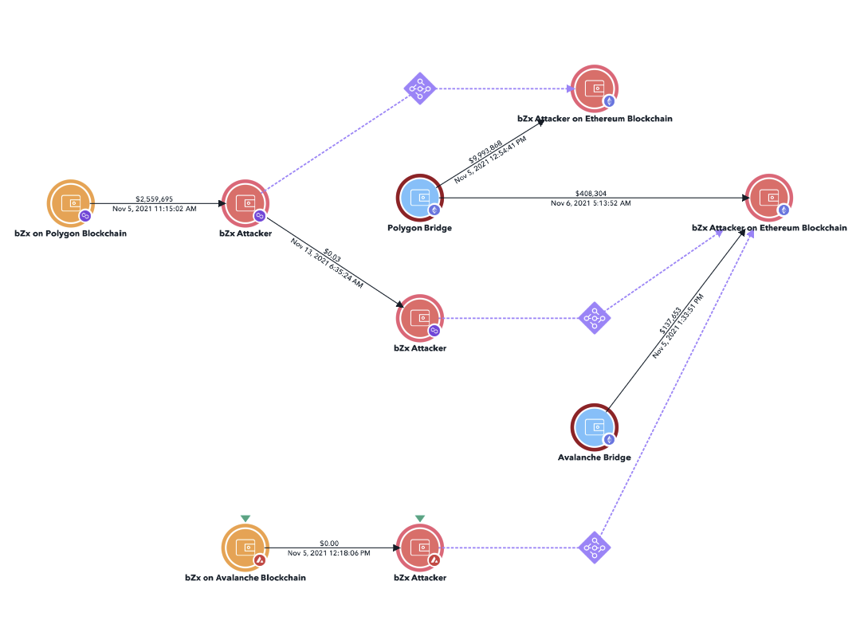

Investigating PB Scams
Blockchain tracing and analysis
Open-source intelligence (“OSINT”)
Subpoenas to crypto exchanges, ISPs, banks, and other third parties

Slide 6
What’s next?
AI-enabled “faceswaps” & chatbots
Distribution of seized assets to victims
International diplomacy
Rapid response capabilities

