Slide 1
Oiled Saddles and Greased Guns:
Damages Experts Battle Over EcoFactor and Recent Case Law

Slide 2


EcoFactor v. Google (Fed. Cir. 2025) (en banc)
The parties are requested to file new briefs, which shall be limited to addressing the district court’s adherence to Federal Rule of Evidence 702 and Daubert v. Merrell Dow Pharmaceuticals, Inc., 509 U.S. 579 (1993), in its allowance of testimony from EcoFactor’s damages expert assigning a per-unit royalty rate to the three licenses in evidence in this case.
Notes:
Source: Lex Machina

Slide 3
EcoFactor v. Google (Fed. Cir. 2025) (en banc)
Majority Opinion (MOORE, Lourie, Dyk, Prost, Taranto, Chen, Hughes, and Stoll)
Distinguishing “the gatekeeping role of the judge” under Rule 702 from the fact finder’s role “is particularly essential in the context of patent damages.” Apple Inc. v. Motorola, Inc., 757 F.3d 1286, 1315 (Fed. Cir. 2014), overruled on other grounds by Williamson v. Citrix Online, LLC, 792 F.3d 1339 (Fed. Cir. 2015) (en banc in part). Estimation of a reasonable royalty by its nature “necessarily involves an element of approximation and uncertainty.”

Slide 4
EcoFactor v. Google (Fed. Cir. 2025) (en banc)
Majority Opinion (MOORE, Lourie, Dyk, Prost, Taranto, Chen, Hughes, and Stoll)
Three EcoFactor Licenses
The plain language of the license agreements does not support Mr. Kennedy’s testimony that Daikin, Schneider, and Johnson agreed to pay the $X per unit royalty rate. In fact, the Daikin and Schneider licenses expressly disavow it. The “whereas” recital of each license provides no indication that the licensees agreed to pay the $X rate or shared EcoFactor’s belief that $X constituted a reasonable royalty. The licenses therefore do not, individually or in combination, provide support for Mr. Kennedy’s testimony that the licensees agreed to pay the $X rate or that the licensees agreed that $X was a reasonable royalty. This analysis does not usurp the province of the jury, nor does it involve this court deciding disputes of fact. It involves the gatekeeping function of the court to ensure that there are sufficient facts or data for Mr. Kennedy’s testimony that the licensees agreed to the $X royalty rate.

Slide 5
EcoFactor v. Google (Fed. Cir. 2025) (en banc)
Majority Opinion (MOORE, Lourie, Dyk, Prost, Taranto, Chen, Hughes, and Stoll)
Testimony of EcoFactor CEO
Mr. Habib’s testimony amounts to an unsupported assertion on behalf of EcoFactor that the $X rate was applied to calculate the lump-sum payment amounts. Mr. Habib testified that neither he nor anyone at EcoFactor had knowledge about the sales figures which would be needed to convert the $X royalty rate into the lump-sum payment amounts. See J.A. 5691 at 555:12–20; J.A. 5695 at 559:613; J.A. 5697–98 at 561:21–562:4. His testimony referenced no evidentiary support. It did not include actual, projected, or even estimated sales figures. He relied entirely on his asserted “general understanding of the space,” J.A. 5670 at 534:22–23, without ever explaining how a general understanding informed him as to the missing sales data. In the absence of any evidence, Mr. Habib’s testimony amounts to an unsupported assertion from an interested party. His testimony cannot provide a sufficient factual basis for Mr. Kennedy to provide a reliable opinion that the licensees agreed to pay the $X rate.

Slide 6
EcoFactor v. Google (Fed. Cir. 2025) (en banc)
Majority Opinion (MOORE, Lourie, Dyk, Prost, Taranto, Chen, Hughes, and Stoll)
Abuse of Discretion
This is not a case where the relevant evidence can reasonably support competing conclusions. Whether prior licensees agreed to pay the $X rate was not the subject of estimation or approximation in Mr. Kennedy’s reasonable royalty analysis. In other words, this is not an issue involving unavoidable imprecision on which Mr. Kennedy’s expertise was brought to bear. To the contrary, this was a concrete factual premise of Mr. Kennedy’s testimony, which he asserted to be true based on the licenses and the testimony of Mr. Habib. There can be no doubt that this evidence fails to provide “good grounds” for Mr. Kennedy’s testimony regarding the licensees’ agreement to pay $X per unit. See Daubert, 509 U.S. at 590. Nor did Mr. Kennedy have access to evidence of relevant sales figures to verify whether the lump sums corresponded to a particular unit-based rate. Without this fundamental premise, Mr. Kennedy’s testimony unravels. Where, as here, the relevant evidence is contrary to a critical fact upon which the expert relied, the district court fails to fulfill its responsibility as gatekeeper by allowing the expert to testify at trial.

Slide 7
EcoFactor v. Google (Fed. Cir. 2025) (en banc)
Dissent (STARK, Reyna)
Nevertheless, because this is our first en banc review of a utility patent case in years, I am concerned that today’s opinion will be misinterpreted as constraining damages experts in a manner not called for by either Rule 702 or Daubert. I fear, too, that the Majority may be misunderstood as inviting district judges, and future panels of this court, to resolve fact disputes under the guise of evaluating whether experts may testify at trial.
* * *
The quarrel over how the record before us should be understood should not, however, obscure an important reality: today’s decision only governs where an expert’s testimony is undoubtedly contrary to a critical fact upon which the expert relies. Thus, in the vast majority of patent cases, where the relevant evidence the experts are considering can support competing conclusions, the Majority Opinion is inapplicable.

Slide 8
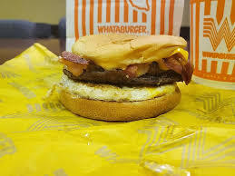
The Impact of EcoFactor in Damages Cases
Radical Change or Nothing Burger?

Slide 9
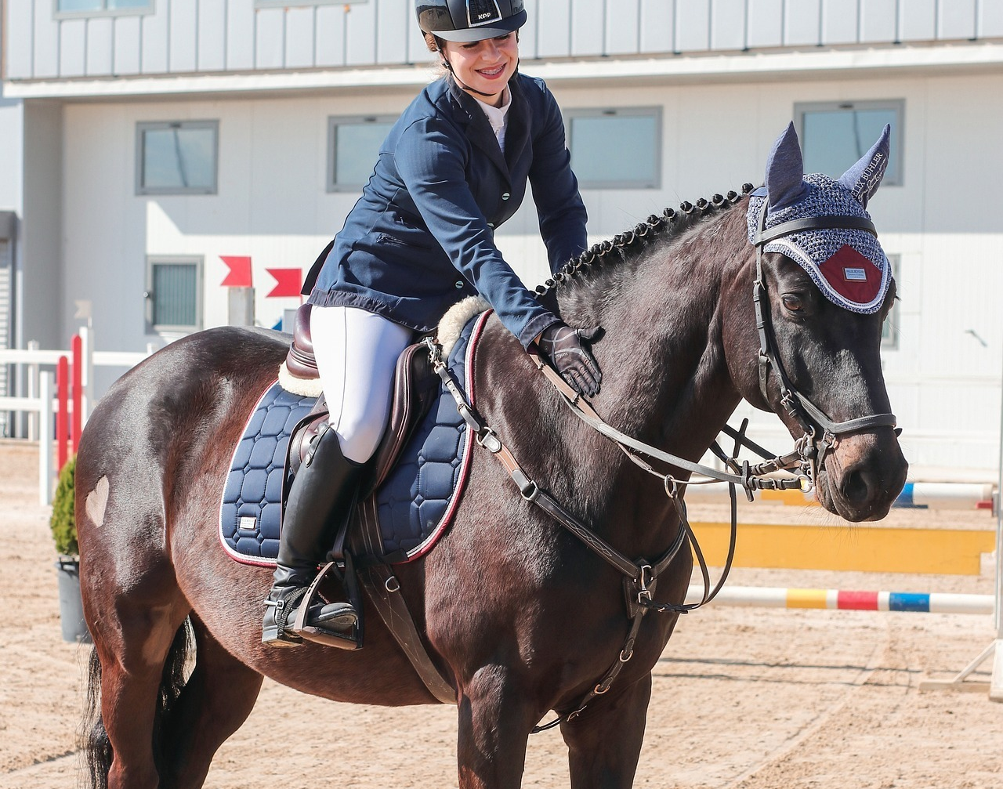
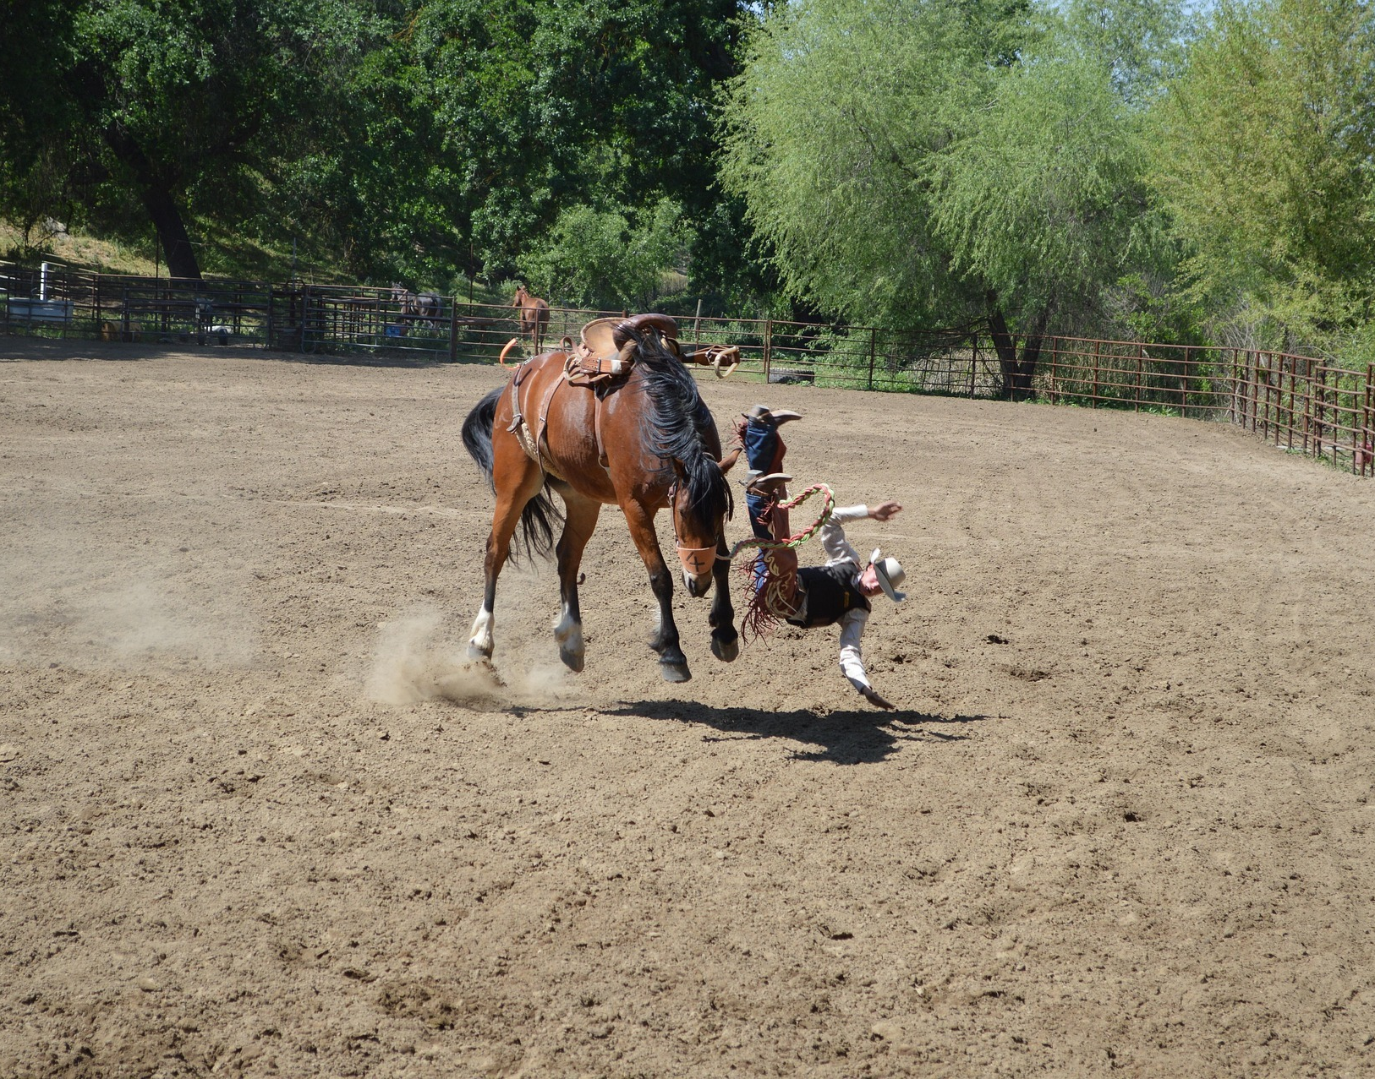
Implications for Drafting and Analyzing Settlement Agreements
Saddled-up or Bucked off?

Slide 10
Altria v. Reynolds Vapor Co. (Fed. Cir. 2024)
Majority Opinion (PROST, Reyna)
Lump Sum Conversion
Altria offered several theories supporting the proposition that a comparable license used a 5.25% royalty rate, and it suffices for our purposes to identify one supported by the evidence. Altria sought to use a comparable license to prove its damages. One was a license between two companies, Fontem and Nu Mark. One part of this license is a lump-sum payment from Nu Mark to Fontem of $43 million granting Nu Mark the right to practice Fontem's patents in the United States until at least 2030. To calculate the effective per-unit royalty rate from this lump-sum payment, Altria's damages expert relied on a projection made by Nu Mark. This projection applied a 5.25% royalty to sales from 2017 to 2023 and resulted in $44 million of estimated royalties. J.A. 28365–66. Thus, Altria's expert, noting the similarity between the $43 million lump-sum payment and the $44 million in projected sales, concluded that the $43 million lump-sum payment in the Fontem-Nu Mark license was calculated using a 5.25% per-unit royalty rate.

Slide 11
Altria v. Reynolds Vapor Co. (Fed. Cir. 2024)
Majority Opinion (PROST, Reyna)
(Lack of) Apportionment
Altria's technical expert began by looking at the licensed technology in the Fontem-Nu Mark license and separating it into thirteen groups of patents. J.A. 28185. The technical expert gave four groups of these patents zero value because they reflected abandoned patent applications. J.A. 28185. He gave three other groups only nominal value because they were directed to small components of an e-cigarette device. J.A. 28185–86. He also gave a family of design patents nominal value as trivial to design around. J.A. 28186. For the remaining five patent families, Altria's technical expert examined the importance of the patents to the e-cigarette device licensed in the Fontem-Nu Mark license and concluded that, because the five patent families covered the key features of an e-cigarette device, selling an e-cigarette device would necessarily require practicing Fontem's patents. J.A. 28188–92. Altria's technical expert also testified that Altria's patents covered the key features of a pod vapor device and thus that selling a pod vapor device would necessarily require practicing Altria's patents. J.A. 28192. Thus, Altria's technical expert concluded that the importance of the licensed patents to the Fontem-Nu Mark license were similar to the importance of Altria's patents to the hypothetical negotiation.

Slide 12
Altria v. Reynolds Vapor Co. (Fed. Cir. 2024)
Majority Opinion (PROST, Reyna)
Reynolds presents several challenges to the methodology and evidentiary basis for Altria's damages expert's apportionment testimony. What Reynolds's challenges amount to, though, are disagreements with the particular adjustments that Altria's damages expert made to the royalty rate in the Fontem-Nu Mark license. While our law requires Altria to “account for differences in the technologies and economic circumstances of the contracting parties,” Finjan, Inc. v. Secure Computing Corp., 626 F.3d 1197, 1211 (Fed. Cir. 2010), we do not require any specific adjustment to a royalty rate based on those differences. Rather, what matters is that Altria's damages expert employed “reliable principles and methods,” Fed. R. Evid. 702(c), that were “based on sufficient facts or data,” id. 702(b), and that the expert's opinion “reflects a reliable application of principles and methods to the facts of the case,” id. 702(d).

Slide 13
What About Apportionment – Altria v. R.J. Reynolds Vapor Co.
What is built in apportionment?
Are we even talking about built in apportionment in Altria?
More of a reminder to focus on technical comparability and the need to adjust for differences
We’ve encountered this issue many times and expect to continue to see it in the future
How does Altria compare to other recent Fed. Cir. discussions on these topics?
Jiaxing v. Super Lighting
RexMed v. Intuitive
Apple v. Wi-Lan (discussed last year)

Slide 14
Altria v. R.J. Reynolds Vapor Co. – Cert. Petition
“Yet after the petitioner filed its opening en banc brief, the Federal Circuit took the extraordinary step of issuing a precedential order ruling [built in apportionment] removed from the case and directing respondent not to brief it. Id.; EcoFactor, Inc. v. Google LLC, 122 F.4th 892, 893 (Fed. Cir. 2024).”
“Altria and its expert performed no apportionment of the royalty rates and they drew from the prior licenses, on the theory the apportionment was already “built in” to those licenses. That is, Altria contended that the jury could apply the same rate its expert contended had been agreed upon in the prior agreements . . . making no further adjustments to the rate to account for the differences between those prior licenses and the circumstances of this case.”
“In short, because Altria’s technical expert offered only a ‘superficial recitation’ of the advantages of the claimed patented invention and failed to isolate the value of Altria’s patents over the prior art, his testimony was insufficient for admissibility. . . Under the approach adopted by the en banc Federal Circuit in EcoFactor, Altria’s expert did not have ‘good grounds’ for his testimony.”

