Slide 1
Cactus is Prickly and Some Jurors Can Be Too

Slide 2
Demographic Comparison of Eastern District of Texas Federal Courts
October 2023
Confidential and privileged work product. The contents of this report constitute proprietary information.

Slide 3
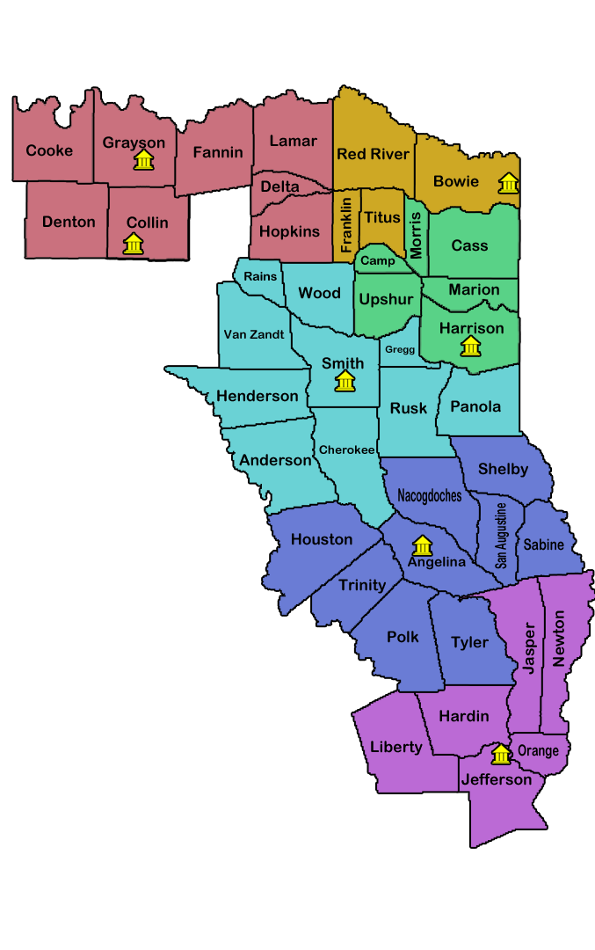
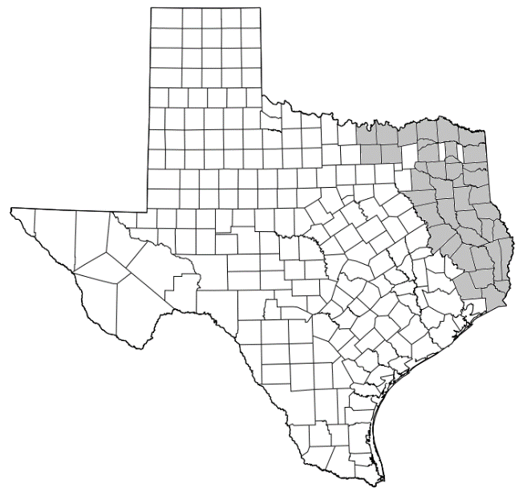
6 Divisions of Eastern District of Texas
Beaumont
Liberty
Hardin
Jefferson
Orange
Jasper
Newton
Tyler
Rains
Wood
Van Zandt
Henderson
Smith
Gregg
Anderson
Cherokee
Rusk
Panola
Lufkin
Houston
Trinity
Polk
Tyler
Angelina
Nacogdoches
Shelby
Sabine
San Augustine
Marshall
Cass
Morris
Camp
Upshur
Marion
Harrison
Sherman
Cooke
Denton
Collin
Grayson
Fannin
Lamar
Delta
Hopkins
Texarkana
Franklin
Bowie
Titus
Red River
Confidential and privileged work product. The contents of this report constitute proprietary information.

Slide 4
Population of EDTX Divisions
Beaumont – 540,103
Lufkin – 303,107
Marshall – 175,341
Sherman – 2,361,959
Texarkana – 145,403
Tyler – 749,630
*Information from the US Census Bureau 2022/2023
Confidential and privileged work product. The contents of this report constitute proprietary information.

Slide 5
Ethnicity
*Information from the US Census Bureau 2022/2023
Confidential and privileged work product. The contents of this report constitute proprietary information.

Slide 6
Level of Education
*Information from the US Census Bureau 2022/2023
Confidential and privileged work product. The contents of this report constitute proprietary information.

Slide 7
Median Household Income
Per Capita Income
*Information from the US Census Bureau 2022/2023
Confidential and privileged work product. The contents of this report constitute proprietary information.

Slide 8
Home Ownership
*Information from the US Census Bureau 2022/2023
Confidential and privileged work product. The contents of this report constitute proprietary information.

Slide 9
Juror Opinions EDTX Compared to Venues Outside of EDTX
The following information has been compiled by JuryScope in working with mock jurors between April 2011 and September 2023.
Confidential and privileged work product. The contents of this report constitute proprietary information.

Slide 10
How much confidence do you have in the courts and legal system?
Confidential and privileged work product. The contents of this report constitute proprietary information.

Slide 11
A legal case must have some merit if it is not settled before trial.
Confidential and privileged work product. The contents of this report constitute proprietary information.

Slide 12
The larger a company, the less I trust it.
Confidential and privileged work product. The contents of this report constitute proprietary information.

Slide 13
An important function of juries in America is to send messages to corporations to improve their behavior.
Confidential and privileged work product. The contents of this report constitute proprietary information.

Slide 14
Individuals or small businesses have little chance of protecting their interests when they conflict with powerful groups or large corporations.
Confidential and privileged work product. The contents of this report constitute proprietary information.

Slide 15
Juror Opinions EDTX Compared to Venues Outside of EDTX
Pre-Covid to Post-Covid Comparisons
The following information has been compiled by JuryScope in working with mock jurors between January 2017 and September 2023.
Confidential and privileged work product. The contents of this report constitute proprietary information.

Slide 16
How much confidence do you have in the courts and legal system?
Pre-Covid
Jan 2017-Feb 2020
Covid
Mar 2020-Mar 2022
Post-Covid
Apr 2022-Sep 2023
Confidential and privileged work product. The contents of this report constitute proprietary information.

Slide 17
A legal case must have some merit if it is not settled before trial.
Pre-Covid
Jan 2017-Feb 2020
Covid
Mar 2020-Mar 2022
Post-Covid
Apr 2022-Sep 2023
Confidential and privileged work product. The contents of this report constitute proprietary information.

Slide 18
The larger a company, the less I trust it.
Pre-Covid
Jan 2017-Feb 2020
Covid
Mar 2020-Mar 2022
Post-Covid
Apr 2022-Sep 2023
Confidential and privileged work product. The contents of this report constitute proprietary information.

Slide 19
An important function of juries in America is to send messages to corporations to improve their behavior.
Pre-Covid
Jan 2017-Feb 2020
Covid
Mar 2020-Mar 2022
Post-Covid
Apr 2022-Sep 2023
Confidential and privileged work product. The contents of this report constitute proprietary information.

Slide 20
Individuals or small businesses have little chance of protecting their interests when they conflict with powerful groups or large corporations.
Pre-Covid
Jan 2017-Feb 2020
Covid
Mar 2020-Mar 2022
Post-Covid
Apr 2022-Sep 2023
Confidential and privileged work product. The contents of this report constitute proprietary information.

Slide 21
Verdict Data

Slide 22
Verdict Data By Year
Plaintiff Wins Defense Wins
Notes:
P-11 D – 5
P-6 D-2
P-3 D-3
P-4 D-1
P-4 D-6
P-9 D-2
P-7

