Slide 1
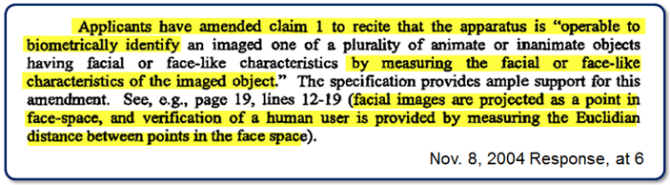
Eigenfaces Are Different
The ’XXX Patent uses a very simple approach called Eigenfaces, which reduces each face to a single point in “face space”
Eigenfaces reduces each face to a single point in “face space”

Slide 2
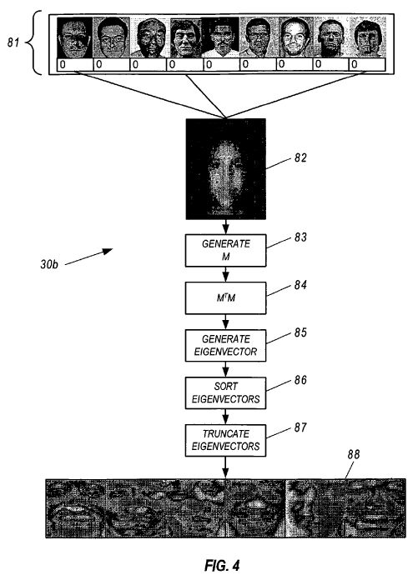
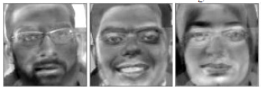
Eigenfaces Are Different
Examples of eigenfaces:
Captured facial images are expressed as combinations of these eigenfaces

Slide 3

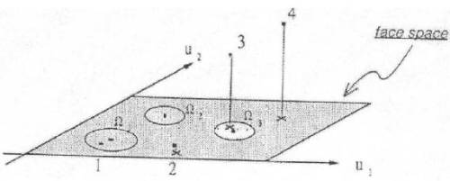

Eigenfaces Are Different
Recognition is determined by measuring the distance between different points in face space (the points represent different faces)
TOO FAR, NO MATCH

Slide 4
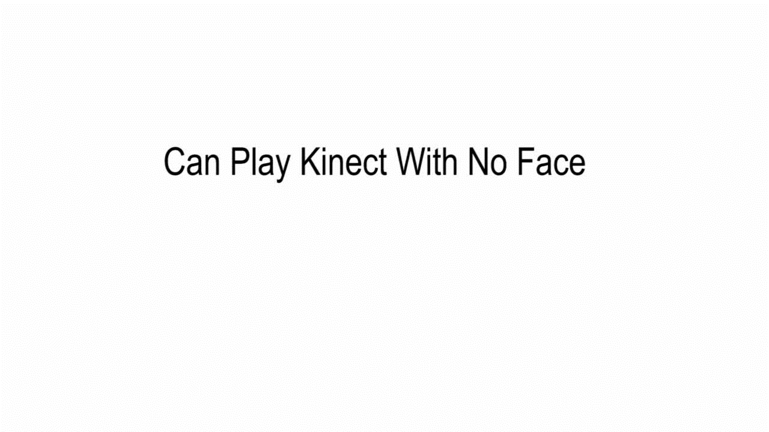
No Facial Recognition Required

Slide 5
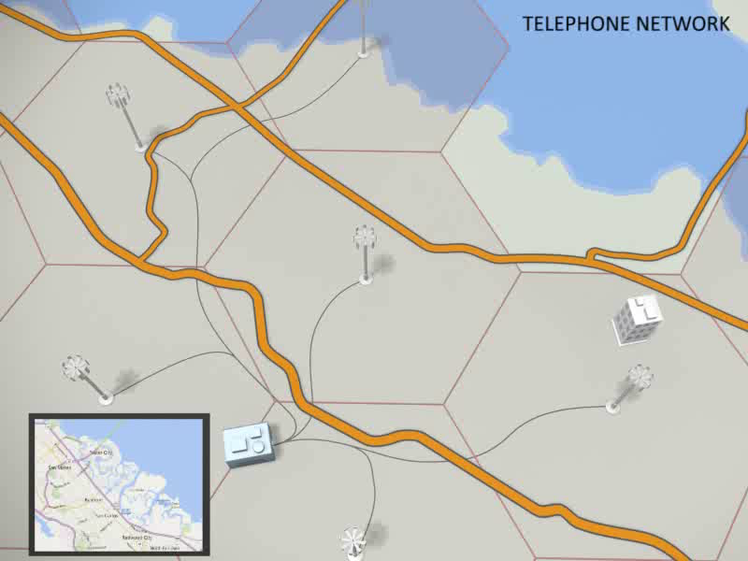
Handoff from Source to Target
ADX-132

Slide 6
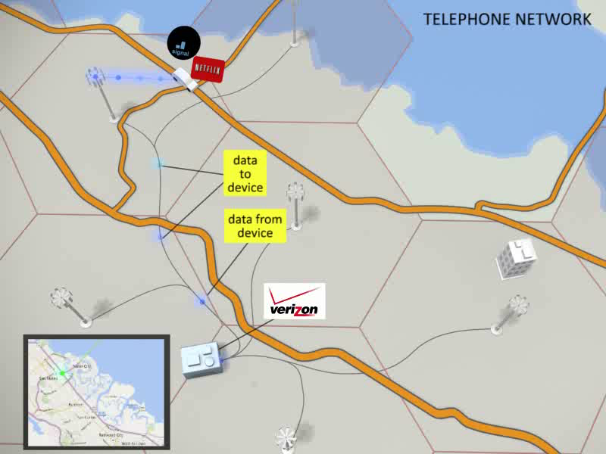
Handoff from Source to Target
ADX-133

Slide 7
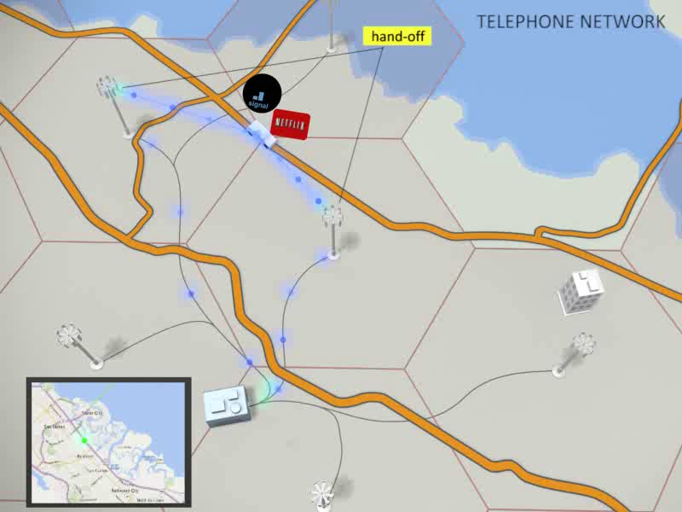
Handoff from Source to Target
ADX-134

Slide 8
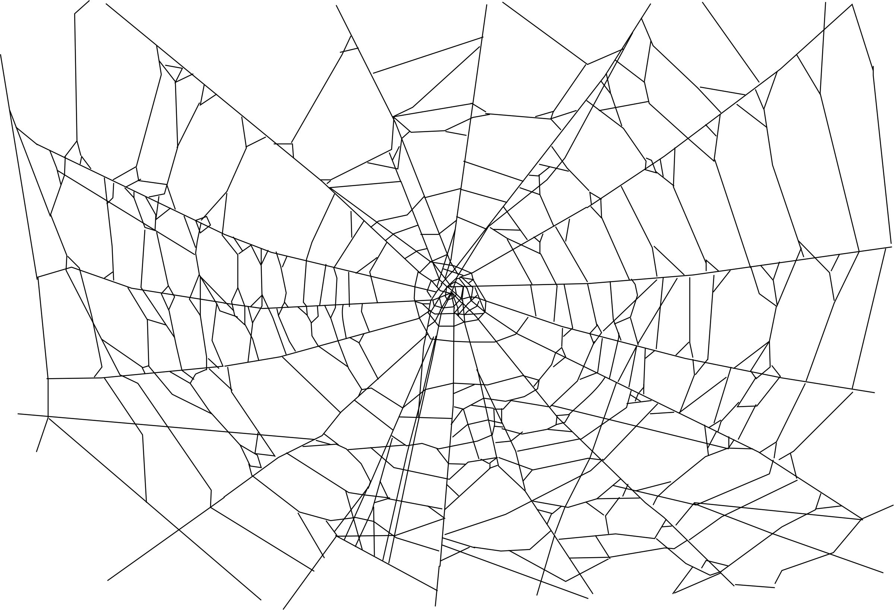
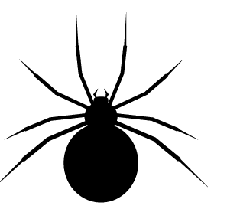

[Opponent]’s Abuses
Exclusivity
No License,
No Chips
Gag Clauses
Extortion of Royalties
Threats to Supply
No Licenses to Competitors
Obstruction of Justice

Slide 9
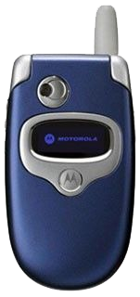
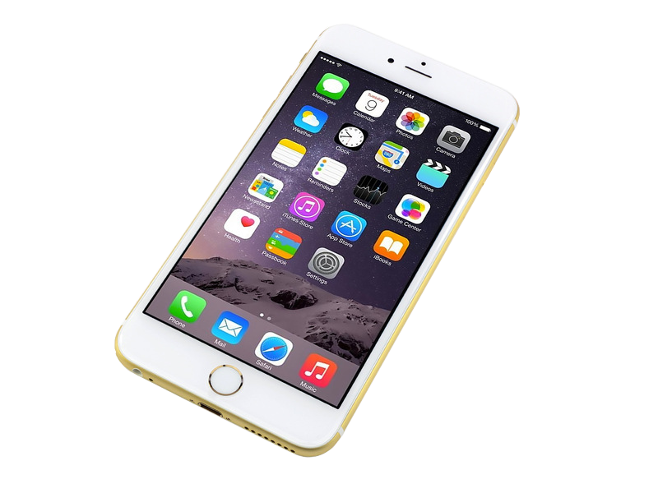
Taxing Innovation
Compare your smartphones to the flip phones we had ten years ago

Slide 10
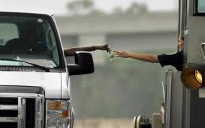

Microsoft Has Already Paid VirnetX Its Toll
Client Has Already Paid the Toll
BUT NOW [PLAINTIFF] WANTS
CLIENT TO PAY AGAIN

Slide 11
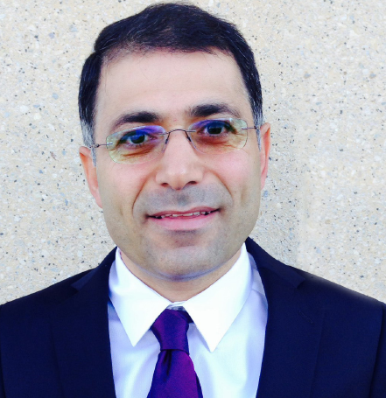
Expert’s Opinion of Evidence: It’s Irrelevant
Plaintiff’s Expert

Slide 13

TCM Creates Symbols
TempCopy
1
0
01
10
1
0
00
11
020.1

Slide 14
Each Point on a Symbol Map Represents a Waveform
TempCopy
0
1
1
0
0 1
0 0
1
1
0
0
020.1

Slide 15
TCM Is Based on Maximizing Euclidean Distance
TempCopy
01
10
Euclidean
Distance
00
11
020.1

Slide 16
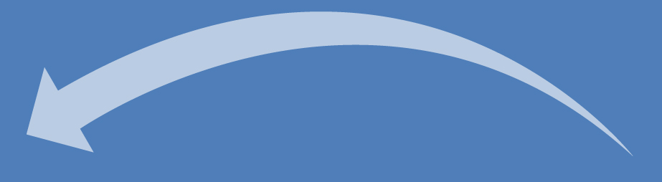
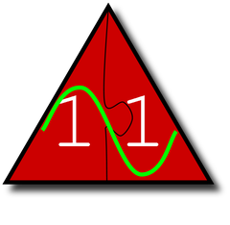
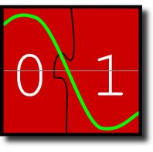
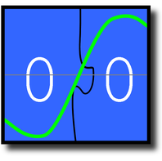
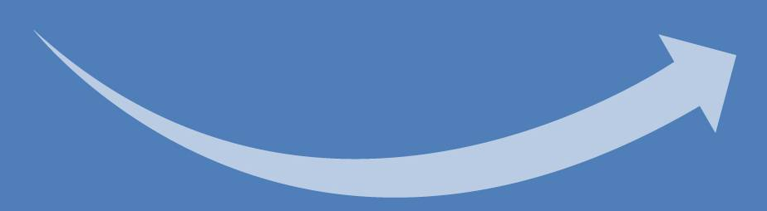
CSIRO’s Patent Requires Special Way to Interleave to Preserve Symbols
0
0
0
0
0
0
1
1
0
1
0
0
0
1
0
1
0
0
034.1

Slide 17
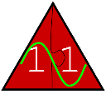
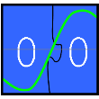
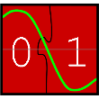
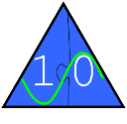
Di-Bit Interleaving Shuffles in Symbols
1
2
3
Mapper
4
Finite State Encoder
5
6
(…)
020.1

Slide 18
Di-Bit Interleaving Shuffles in Symbols
1
2
3
Mapper
4
Finite State Encoder
5
6
(…)
020.1

Slide 19
Di-Bit Interleaving Shuffles in Symbols
1
2
3
Mapper
4
Finite State Encoder
5
6
(…)
020.1

Slide 20
Di-Bit Interleaving Shuffles in Symbols
1
2
3
Mapper
4
Finite State Encoder
5
6
(…)
020.1

